Slide 1
Online Shopper Purchase Intention
- Hariharan Selvam

Slide 2
Table of Contents
Problem Statement
Dataset Overview
Attributes
Data Preprocessing
Exploratory Data Analysis
Insights
Model Building
Conclusion
Recomendations

Slide 3
Problem Statement
Identify the factors that will help to improve the customers count on an online shopping site.
Dataset Overview:
Source: https://archive.ics.uci.edu/dataset/468/online+shoppers+purchasing+intention+dataset
Has 12330 observations with 18 features.
14 numerical
4 categorical

Slide 4
Attributes:
Administrative', 'Administrative_Duration', 'Informational', 'Informational_Duration', 'ProductRelated’, 'ProductRelated_Duration', - number of different types of pages visited by visitor in that session and total time spent in each of these page categories
'BounceRates’, - Entering site and exits without any impact
'ExitRates’, - Chances of site being the last page they visited
'PageValues’- Average value of web page user visited before completing an e-commerce transaction
-'SpecialDay’, - Special Day or event
'OperatingSystems', 'Browser', 'Region’ 'TrafficType – Servers
'Month’,
'VisitorType’,
'Weekend’,
'Revenue’.

Slide 5
Data Preprocessing:
Dropping Duplicates:
After dropping duplicates, no. of observations got reduced to 12205.
Checking for Missing values:
No missing values in this dataset
List of Numerical Variables:
Administrative', 'Administrative_Duration', 'Informational', 'Informational_Duration', 'ProductRelated', 'ProductRelated_Duration', 'BounceRates', 'ExitRates', 'PageValues', 'SpecialDay', 'OperatingSystems', 'Browser', 'Region', 'TrafficType
List of Categorical variables:
'Month', 'VisitorType', 'Weekend', 'Revenue’.

Slide 6
Cardinality of categorical variables
Month – 10 unique values
Feb, Mar, Apr, May, June, July, Aug, Oct, Nov, Dec
VisitorType – 3 unique values
Returning visitor, new visitor, other
Weekend -2 unique values
False, True
Revenue- 2 unique values
False, True

Slide 7
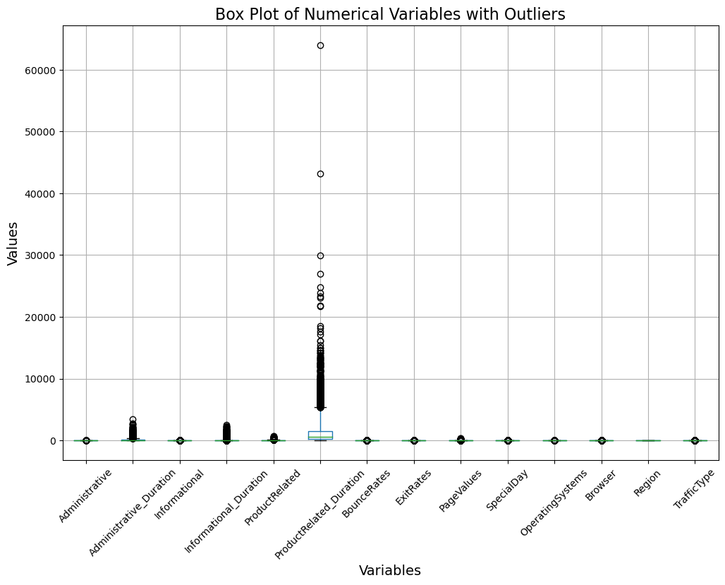
Outliers: Found some and removed it.

Slide 8
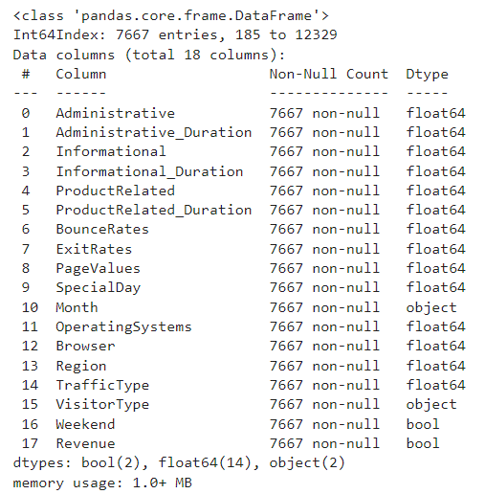
After removing outliers, no. of observations got reduced to 7667.
Cleaned Data:
Rows: 7667
Columns: 18

Slide 9
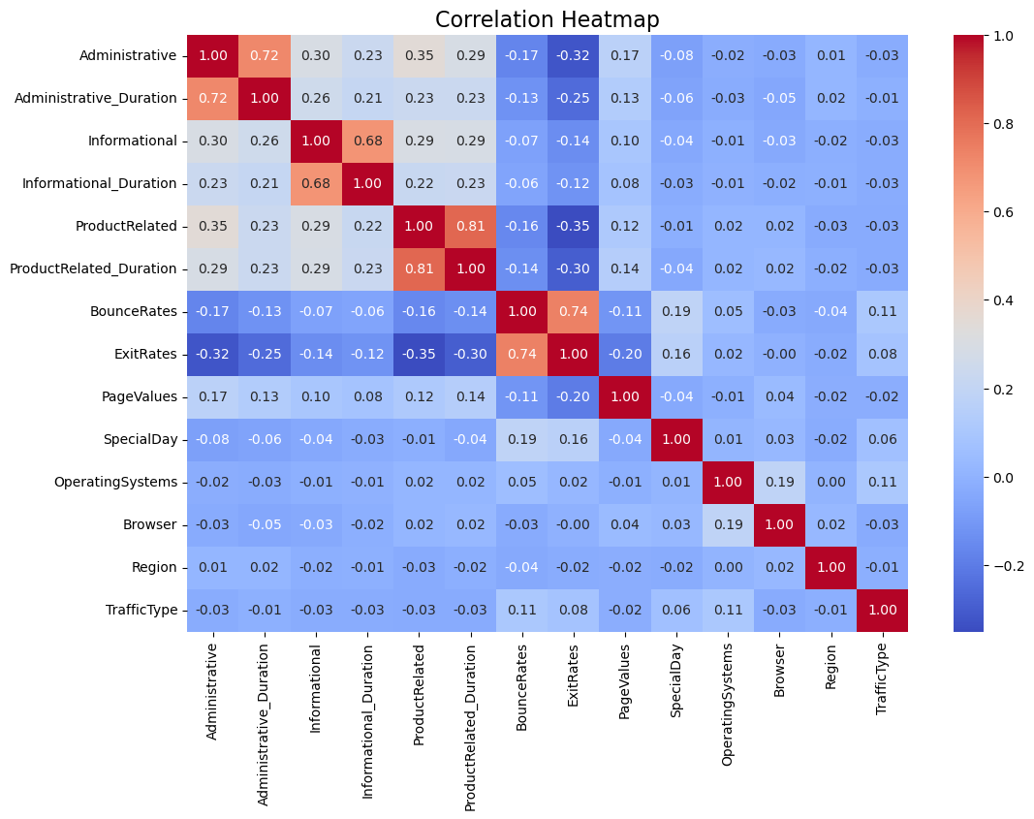
Exploratory Data Analysis:
Strong positive correlation:
Administrative and Administrative_Duration
ProductRelated and ProductRelated_
Duration.
Bounce Rates and Exit Rates
Weak positive correlations:
Informational and ProductRelated
Administrative and Informational
Administrative and ProductRelated
Administrative and PageValues
Weak Negative Correlations:
ProductRelated and Bounce Rates
ProductRelated and Exit Rates
Informational and Bounce Rates
Informational and Exit Rates

Slide 10
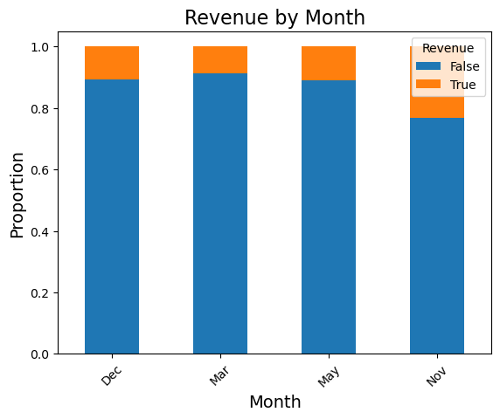
Relationship b/w revenue and month
Revenue got more generated in
March.
Revenue got less generated in
November

Slide 11
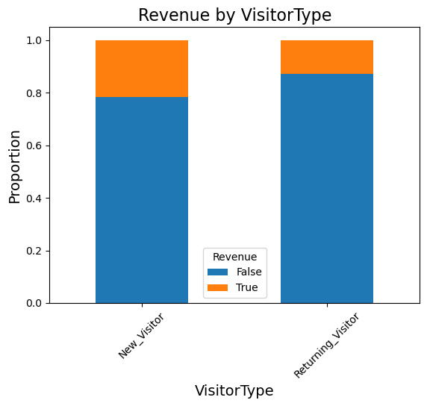
Realtionship b/w Revenue and VisitorType:
Revenue got more generated with the
Help of Returning visitor than New visitor

Slide 12
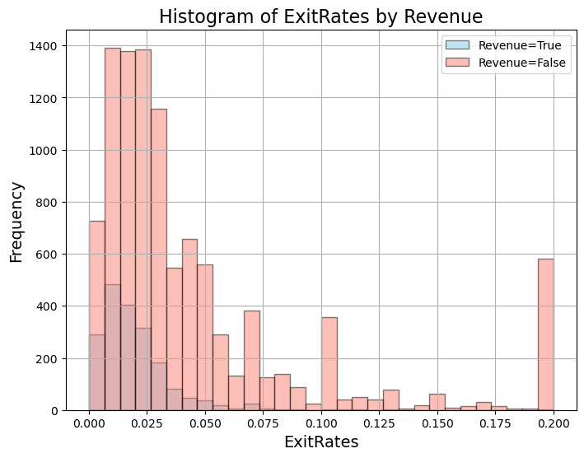
Histogram of ExitRates by
Revenues
The exit rates for sessions with
and without revenue appear to
follow similar distributions.
Negative skew
Skewness: -0.20

Slide 13
Insights:
websites with high informational content tend to also have users who spend more time on informational pages
websites with more product-related content might have slightly lower bounce rates and exit rates.
websites with high bounce rates also tend to have high exit rates
website features might have a small positive impact on user behavior.
type of traffic a website receives might influence the administrative tasks associated with managing that traffic
Returning visitors help for revenue more than new visitors, which is one of the positives for the websites.

Slide 14
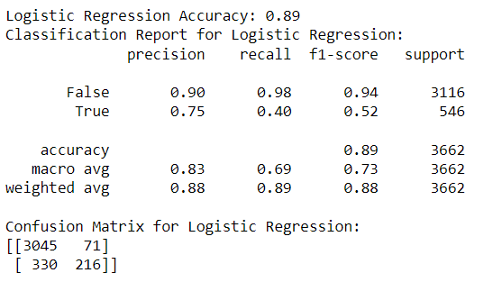
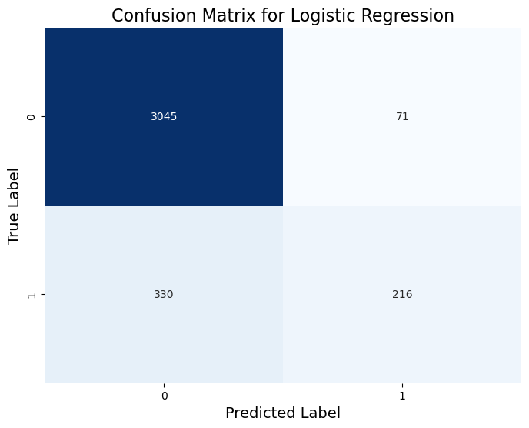
Model Building:
Target: ‘Revenue’
Converted categorical features into dummy variables
Train -70% , Test -30%
Done Logistic Regression and Support Vector Machines

Slide 15
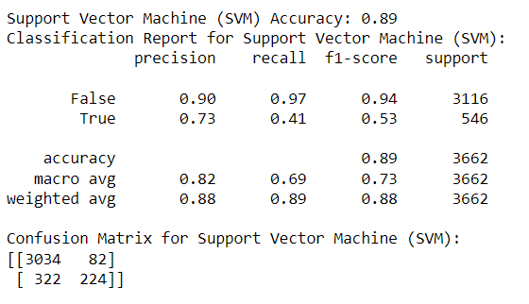
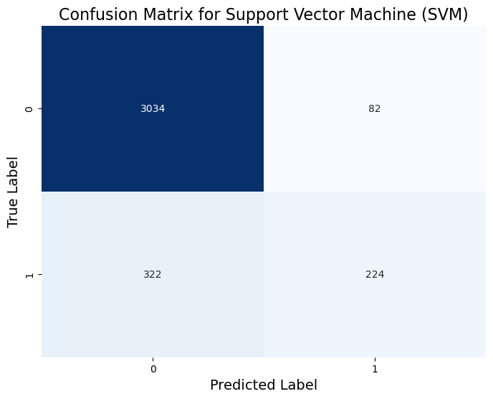

Slide 16
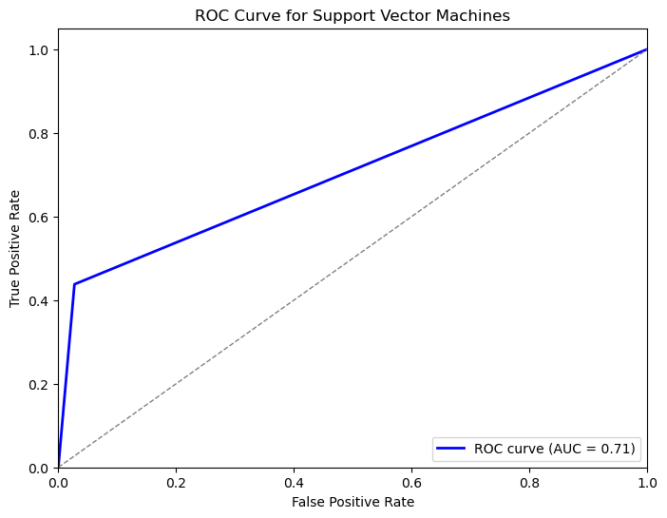
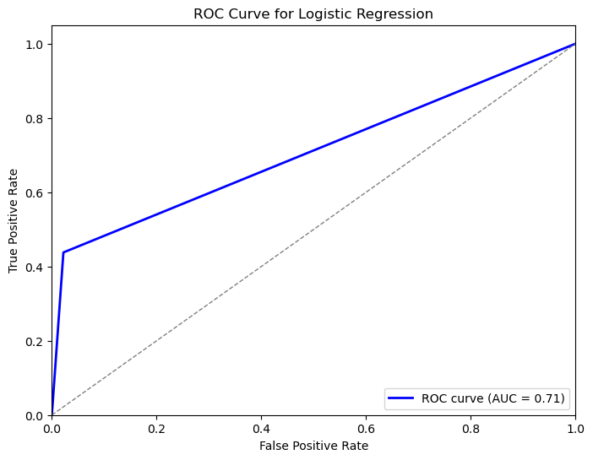
ROC Curve and AUC value:

Slide 17
Conclusion:
Pagevalues, visitortype, special day, month, weekend will help to improve revenue for online shopping site.
These features capture various aspects of user behaviour, engagement and timing which will be crucial for marketing strategies.

Slide 18
Recommendations:
Leverage Recommendation engines.
Seasonal promotions and discounts
Time based promotions
SEO and Social Media Advertising
Landing page optimization
Technical operation and user interface
Newcomer and referral discounts
Personalized e-mail retargeting

